Slide 1
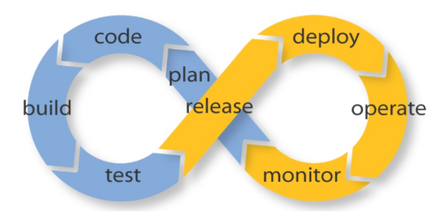
DevOps

Slide 2
What is DevOps?
DevOps is not a tool or a software, it’s a culture that you can adopt for continuous improvement. It will help you to bring your Developer Team and Operations Team on the same page, allowing them to work together with ease.
Create a new environment for your project from scratch.
Help you maintain and optimize your existing environment.
scalability, security, and maintainability.

Slide 3
Why we have to go for DevOps?
Continuous software delivery
Automated process
Time Consumption
Faster resolution of problems
Productivity and Faster Delivery
More stable operating environments

Slide 4
Who will involve in DevOps?
Developer
Build Team
Release team
System Admins
QA team

Slide 5
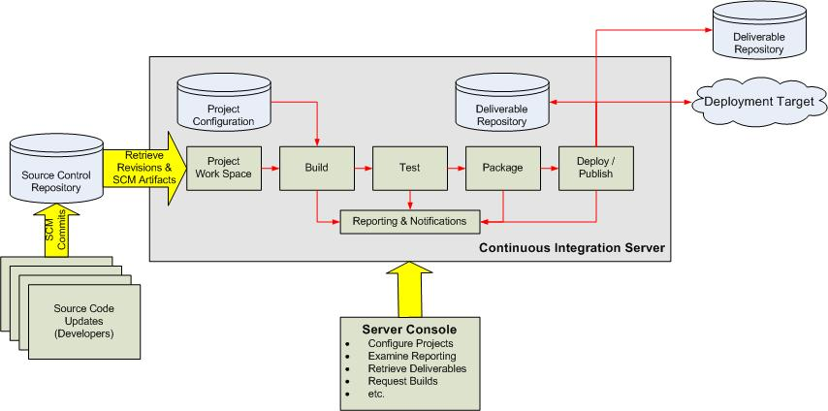
Continuous Integration Overview

Slide 6
Source Code management tools
SVN
GIT
These tools are mainly served to store the code with various versions
Here we will come to know all the minor and major changes of the code with date and time.

Slide 7
Build Tools
Java
  Maven (build-in), Ant, Gradle
.Net
  MSBuild, PowerShell
These tools are used to build the code and it generate executable file
By using build tools we will get the executable files in various formats like .jar, .war and .ear etc..

Slide 8
CI Tools
Jenkins (Open Source)
Anthillpro (Ibm)
Teamcity commercial
Bombo commercail
Here all the process are configured by using CI/CD tools.
Like we need configure SCM , Build and Application servers.
It is automated process where we can pre defined when to pull the code form SCM , when to build by using build tools and where to deploy the executable files.

Slide 9
CI/CD
Automate Provisioning - Infrastructure as Code
Automate Builds – Continuous Integration
Automate Deployments – Defined Deployment Pipeline and
Continuous Deployments with appropriate configurations for the environments
Automate Testing – Continuous Testing, Automated tests after
each deployment
Automate Monitoring – Proper monitors in place sending alerts
Automate Metrics – Performance Metrics, Logs

Slide 10
    THANK YOU

